Slide 1

Software-art SYSTEM ENGINEER
a tour of new features
System Engineer

Slide 2


Project Title: System Utility and USB Antivirus Software
Project Code Name : System Engineer Group Name : Software-Art
Group Members :
Md.Hasibur Rashid Gazi Azizur Rahman
Roll No:43 Roll No:12
Reg.No:01845 Reg.No:02150
7th Semester 7th Semester
Contact Number:+8801827788726 Contact Number:+8801922039659
E-mail:hasib.cse.pstu.bd@gmail.com E-mail:pstucseaziz@gmail.com
Project Supervisor :Md. Naimur Rahman Target Duration : 1 Year Duration : January to December 2013 Location of Project :Patuakhali Science and Technology University, Bangladesh.
INTRODUCTION

Slide 3
What is System Engineer ?
It is system utility software which enhance your windows operating system like other utility software such Gallery utility, Tune-ups, Advance system care etc. But our utility software different from these, because it is totally free software under GPL (General public License), easy to used, full online support, built-in other GPL software, Auto update support and open source and all other facilities that provided other utilities software .
ABOUT PROJECT
Tools & Requirement
Tools: Microsoft Visual studio 2012 express edition, Expression Blend 4, .Net Framework 4, Photoshop CS3 etc.
Language: C#.net (based), XAML, java , windows batch programing etc.

Slide 4
Project Features
Junk file cleaner
Registry Fixer
Ram cleaner
Shortcut fixer
Disk cleaner
Uninstaller
Disk Defragment
Internet service accelerator
Performance optimizer
Windows Tools
Other built-in GPL software
Visual Customizer
Fix OS security holes
Online support
Help & support center
Easy to use
Secure, Fast, Dynamic and Highly graphical
Low configuration system supported
Open source
FEATURES

Slide 5
Project Beneficiaries
1. General users, student, open source developer 2. Small and Medium business service provider
BENEFICIARIES
Project Monitoring
1. Md. Hasibur Rashid — Software Development Part 2. Gazi Azizur Rahman — Web Development Part

Slide 6


Budget and Duration
Duration : January- December 2013 (1 year) Project Area : Perspective of General user, personal and Business use. Target population : 5000(approximately) Total Project Budget : 5000 BDT(approximately)
Funding source : (1) Partnership Fund Contributions (2) Developer Contribution
BUDGET AND DURATION

Slide 7
Project Development Model
Analysis
Requirement specification
MODEL
Design
Implementation
Testing and Integration
Operation and Maintenance
Fig: Water fall model

Slide 8
Development Time Allocation
TIME ALLOCATION

Slide 9


System Follow
System Engineer
Information
Optimizer
Security
Customization
System Tools
Support
System information
Network
Performance
One click Cleaner
Ram cleaner
Registry cleaner, Registry Dig
Temp File Cleaner, Shortcut Cleaner
Malware Cleaner
Smart Uninstaller
USB protection
Disk Protection
System customization
Tips &tics
Multimedia
Internal Tools-Windows Tools
External GPL
Network calculator, Refresher
Optimization
About
Help &support
Settings
PROPOSE SOLUTION

Slide 10
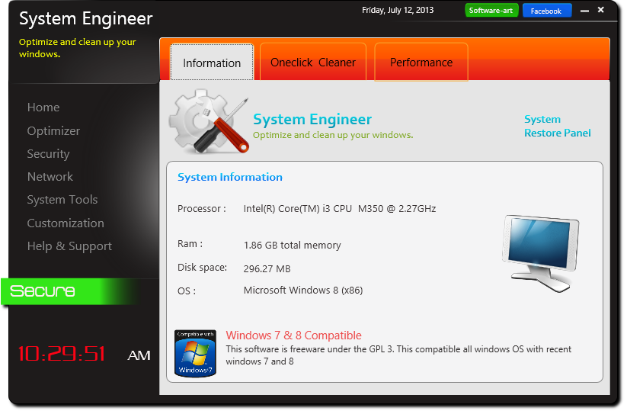
At a glance
DESKTOP SOLUTION
Fig: Main Window

Slide 11
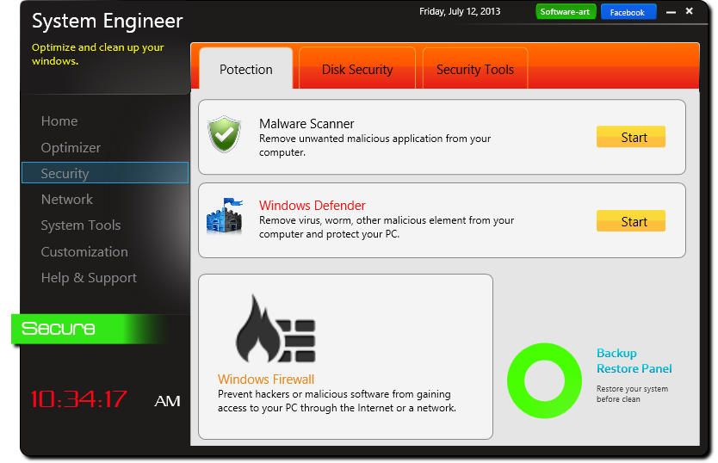
At a glance
DESKTOP SOLUTION
Fig: Security Window

Slide 12
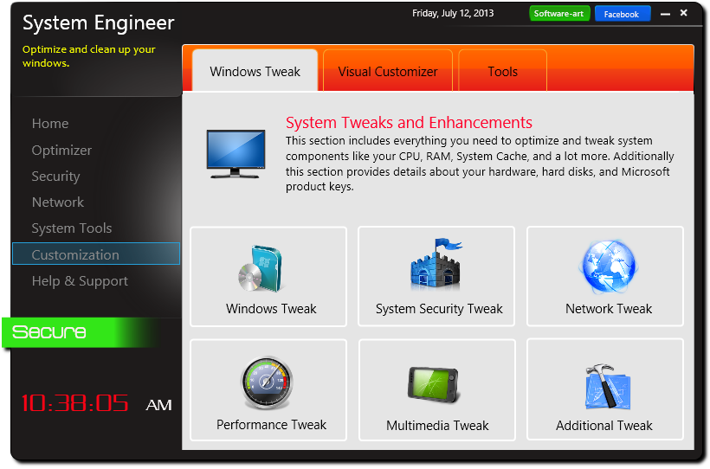
At a glance
DESKTOP SOLUTION
Fig: Customization Window

Slide 13
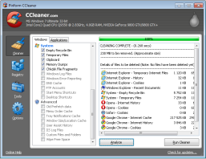
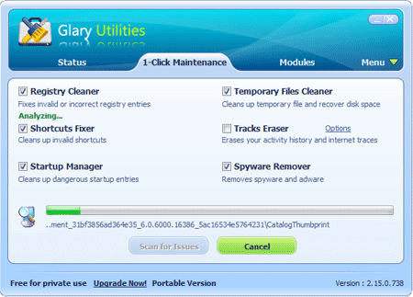
CCleaner
EXISTING SOFTWARE
Glary Utilities

Slide 14
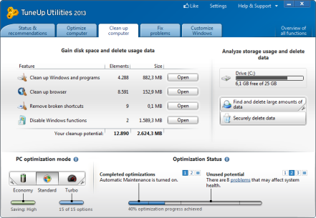
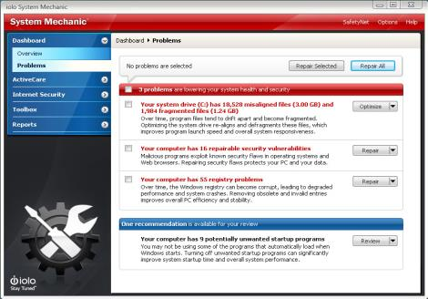
TuneUP Utilities 2013
EXISTING SOFTWARE
System Mechanics Pro 10.5

Slide 15
Comparison with System Engineer, C-Cleaner, Glary Utilities, Tune Up, Advance System Care.
 | C Cleaner | Glary Utilities (Pro) | Tune up (Pro) | Advance system care | System Engineer
Junk file cleaner | Yes | Yes | Yes | Yes | Yes
Registry cleaner | Yes | Yes | Yes | Yes | Yes
Disk Repair | No | Yes | Yes | Yes | Yes
Disk Defragment | No | Yes | Yes | Yes | Yes
Startup Manager | Yes | Yes | Yes | Yes | Yes
Uninstaller | Yes | Yes | Yes | Yes | Yes
Disk Checker | No | Yes | Yes | Yes | Yes
System File repair | No | No | No | No | Yes
Memory Optimizer | No | Yes | Yes | Yes | Yes
Network Connection checker | No | No | Yes | Yes | Yes
Network optimizer | No | No | Yes | Yes | Yes
Windows Tools | Yes | Yes | Yes | No | Yes
External Tools | No | No | No | No | Yes
Security Tools | No | No | Yes | No | Yes
Visual personalization | No | No | Yes | No | Yes
System Tweak | No | No | No | No | Yes
USB Antivirus | No | No | No | No | Yes
Online Support | Yes | Yes | Yes | Yes | Yes
Open source | No | No | No | No | Yes
Comparison

Slide 16

Software-Art Online Support
To give full service like other utility software company, we design and develop a website. From this site, users can download both free and PRO software. They can update their version, repair licenses and also comment about the products.
WEB SOLUTION

Slide 17
Technology
ASP. Net Framework
MVC4
Razor View Engine
WEB SOLUTION
Tools
Microsoft Web Expression 2012
SQL Server (local DB)
Dreamweaver CS6
Language
C#.net, JS, html, html5, CSS3

Slide 18
What is ASP.NET Framework ?
ASP.NET is a server-side Web application framework designed for Web development to produce dynamic Web pages.
It was developed by Microsoft to allow programmers to build dynamic web sites, web applications and web services.
It was first released in January 2002 with version 1.0 of the .NET Framework, and is the successor to Microsoft's Active Server Pages (ASP) technology. ASP.NET is built on the Common Language Runtime (CLR), allowing programmers to write ASP.NET code using any supported .NET language
WEB SOLUTION

Slide 19
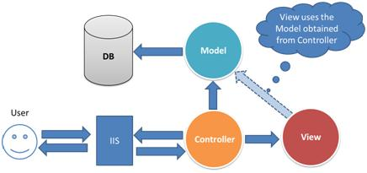
What is MVC ?
ASP.NET MVC 4 is a framework for building scalable, standards-based web applications using well-established design patterns and the power of the ASP.NET and the .NET framework. This new, fourth version of the framework focuses on making mobile web application development easier .
How ASP.NET MVC works:
WEB SOLUTION

Slide 20
Features of MVC ?
Separation of application tasks (input logic, business logic, and UI logic), testability, and test-driven development (TDD) by default.
An extensible and pluggable framework. The components of the ASP.NET MVC framework are designed so that they can be easily replaced or customized.
A powerful URL-mapping component that lets to build applications that have comprehensible and searchable URLs.
Support for existing ASP.NET features. ASP.NET MVC lets to use features such as forms authentication and Windows authentication, URL authorization, membership and roles, output and data caching, session and profile state management, health monitoring, the configuration system, and the provider architecture.
WEB SOLUTION

Slide 21
What is Razor?
Razor is a markup syntax for adding server-based code to web pages
Razor has the power of traditional ASP.NET markup, but is easier to learn, and easier to use
Razor is a server side markup syntax much like ASP and PHP
Razor supports C# and Visual Basic programming languages
Used to create dynamic web pages with the C# or Visual Basic .NET programming languages.
WEB SOLUTION

Slide 22
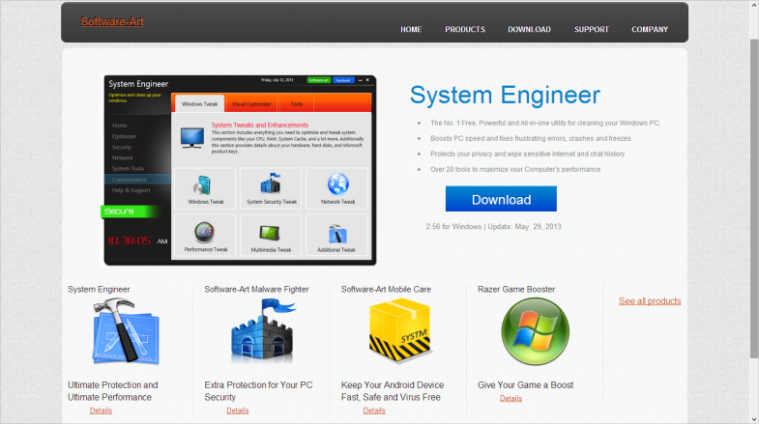
Software-Art website Snap
WEB IMPLEMENTATION

Slide 23
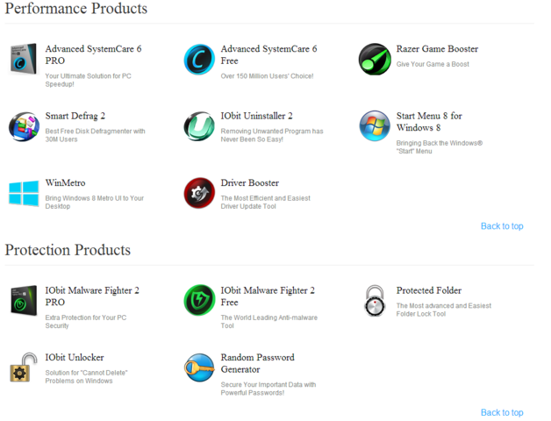
Software-Art website Snap
WEB IMPLEMENTATION

Slide 24
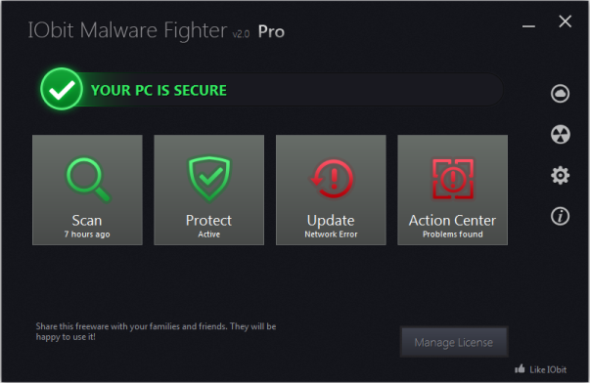
Feature Work
In future very firstly we would complete our unfinished tasks and enhance System Engineer, moreover we would include customize Junk cleaner, Registry cleaner, uninstaller, startup manager, and many more system tweak and other necessary tools.
The key challenge in future is to build a USB antivirus. The model for our upcoming USB antivirus has been shown below.
FUTURE WORK

Slide 25
Limitation
Last but not the least, ”To err is human” We do bear some limitations, this software is totally developed on Windows built-in system tools and API, in case any component of OS fails, the software can’t provide that service.
CONCLUTION
Conclusion
To build a System Utility is always a difficult task. We have tried our best to develop a nice looking, powerful, smart, user friendly, secure and open source freeware software for personal or professional use. We assume it might prove to be helpful for general users, those who have very little knowledge about computer.

Slide 26
Presented by Software-art
Thank you

